Slide 1
CT Failure Monitoring: A Decade of Experience
Published by: Jalal Al Ali

Slide 2
Now, near 1500 units are working worldwide
The operating environment became more arduous with interventions being performed in high pressure wells, sour gas wells and geothermal wells for example
All of the factors would seem combined to decrease Coiled Tubing service reliability
Early failures are those which are experienced before the SWL (Safe Working Life) of a string of tubing has been fully occurred.
Very few strings are actually used until or beyond they reach their maximum allowable SWL.
Predictive Algorithms
1990’s Low Cycle Fatigue Research
Developed
Fatigue Management Softwares
Reduced most of pure cyclic strains induced fatigue failure
Pure cyclic strain: failure not associated with secondary mechanism such as Corrosion

Slide 3
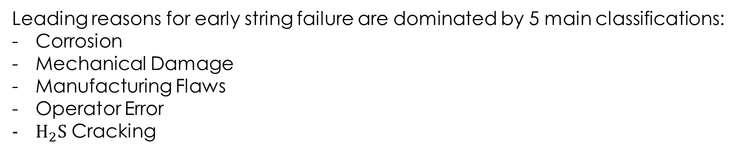
Leading reasons for early string failure are dominated by 5 main classifications:
Corrosion
Mechanical Damage
Manufacturing Flaws
Operator Error
$H_{2}S$ Cracking

Slide 4
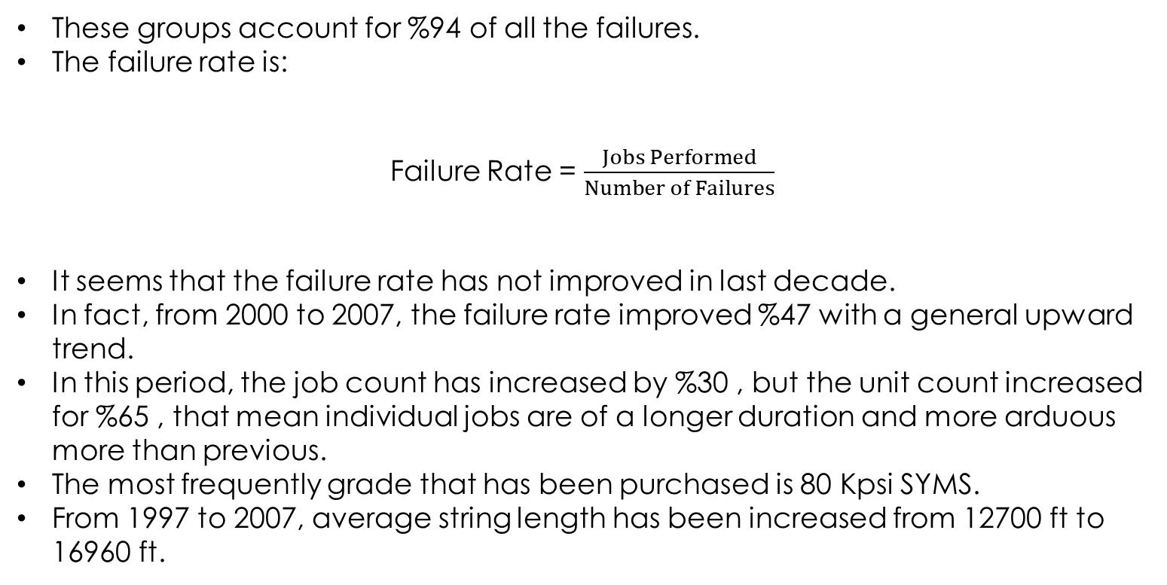
These groups account for %94 of all the failures.
The failure rate is:
Failure Rate = $\frac{Jobs Performed}{Number of Failures}$
It seems that the failure rate has not improved in last decade.
In fact, from 2000 to 2007, the failure rate improved %47 with a general upward trend.
In this period, the job count has increased by %30 , but the unit count increased for %65 , that mean individual jobs are of a longer duration and more arduous more than previous.
The most frequently grade that has been purchased is 80 Kpsi SYMS.
From 1997 to 2007, average string length has been increased from 12700 ft to 16960 ft.

Slide 5
Corrosion
Corrosion occurring during storage of the string
Corrosion due to Acidizing work that has been performed using the string
Influenced By
Influenced By
Abrasive fluids pumped through string
The Environment
The nature of the operation
The duration of exposure of the string with the Acid

Slide 6
Corrosion
Offshore locations suffer from this issue more than land based locations.
Only 1 storage corrosion occurred during 11 years on land based locations.

Slide 7
Mechanical Damage
CT Surface Equipment
Damage Caused while RIH/POOH
Stem from
Caused by
Misuse the Equipment
Reel
Gooseneck
Mechanical Equipment Failure
Injector

Slide 8
Mechanical Damage
Mechanical damage can cause a reduction in the fatigue life of the Coiled Tubing by %75
The proportion of both causes are evenly divided.
Till 2000, %57 of all mechanical dames occurred in CT sizes greater than 1/5”
Since 2000, this proportion raised to %70, so, it mean that %70 of all mechanical damages happened in CT sizes greater than 1/5” .

Slide 9
Manufacturing Flaws
Tube Manufacturing Process
Steel Manufacturing Process
Lack of Fusion
Inclusions in the Weld
Due to
Edge Preparation
Dirt in Tube Plant

Slide 10
CT Wall Thickness
No clear evidence exist that any one wall thickness is likely to suffer any greater susceptibility

Slide 11
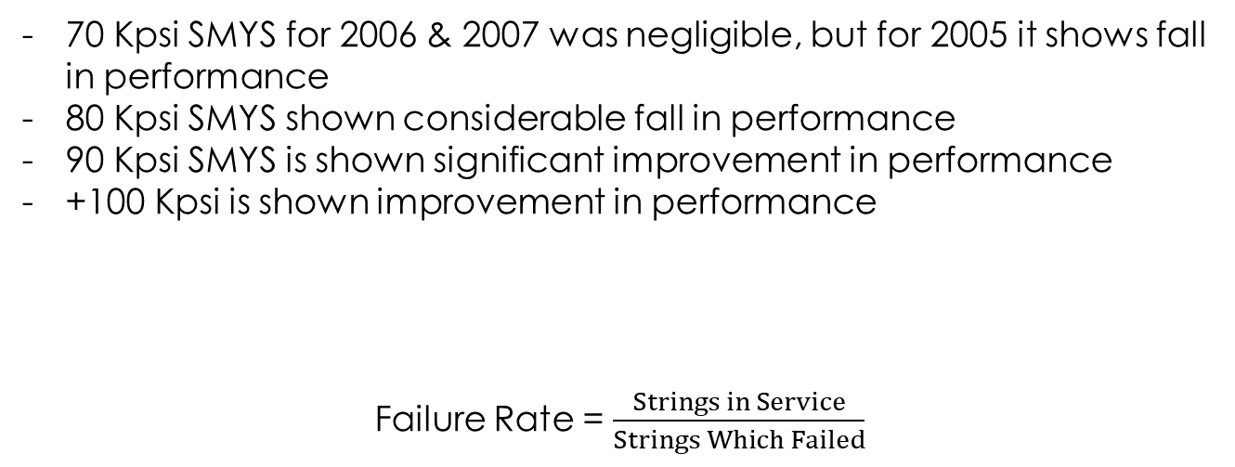
CT Strength Grade
70 Kpsi SMYS for 2006 & 2007 was negligible, but for 2005 it shows fall in performance
80 Kpsi SMYS shown considerable fall in performance
90 Kpsi SMYS is shown significant improvement in performance
+100 Kpsi is shown improvement in performance
Failure Rate = $\frac{Strings in Service}{Strings Which Failed}$

Slide 12
CT Diameter
There is a general shift towards the longer diameter strings
Supposed more of this longer diameter strings are subject to failure
1.75”
2”
2.375”
2.5 X
4 X
2 X
1.5” Failure Ratio

Slide 13
Land and Offshore
Land-Based jobs are 10 X more than Offshore jobs
Greater proportion of string failures occur on Land-Based equipment
Failure rate in Land-Based locations is far less than Offshore locations.

Slide 14
Fatigue
The majority of strings fail prior to %75 of the consumed Safe Working Life (SWL)
This proportion has not altered during last decade

Slide 15
Conclusion
The major causes of early failure have remained unchanged and account for nearly 94% of all such failures.
The overall trend is so higher reliability.
The raw data alone can lead to skewed view and must be set against the context of changing fleet size and make-up in order to fully identify trends in the data.
There has been a move towards, longer and stronger strings, all of which have a higher susceptibility.
Although fatigue failures are virtually unheard of, there is still a need to continue to conduct research on CT low cycle fatigue performance as tubing continues to be used under increasingly arduous conditions.
Offshore strings are at greater risk, predominantly from corrosion both from the environment and from the fluids pumped through them.
Maintenance of these types of statistics allows for the observation of trends.

